Slide 1

Familiarize yourself with phishing attacks
<HR &
Marketing Teams>

Slide 2
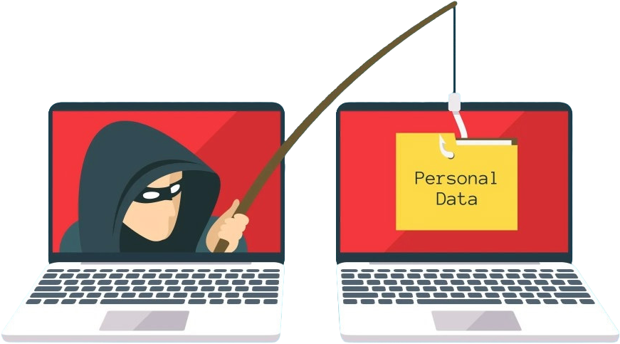
What is
Phishing?
Phishing is a type of online scam where someone tries to trick you into giving away your personal information
—like your password, bank details, or OTP—by pretending to be someone you trust.
Simple Explanation (Layman Style)
If you believe them and share your PIN, they can steal your money. That’s exactly what phishing is—but it usually happens through emails, text messages, or fake websites.
Why it’s called “Phishing” Scammers are like fishermen: They throw bait (fake messages)
They wait for someone to bite (trust them) Then they steal information
Imagine someone calls you pretending to be your bank and says:
“Your account has a problem. Please tell me your PIN to fix it.”

Slide 3

Common
Examples
A message saying: “Your bank account will be blocked. Click here to verify now.”
An email that looks like it’s from PayPal or GTBank asking you to log in
A fake website that looks exactly like your bank’s website
WhatsApp messages promising free giveaways but asking you to “log in”
Signs of Phishing
Urgent messages (“Act now or lose your account!”)
Strange links or misspelled website names Requests for sensitive info (PIN, password, OTP)
Messages from unknown or suspicious numbers/emails

Slide 4

How to Protect Yourself
Never share your password, PIN, or OTP Don’t click suspicious links.
Always check the real website URL
If unsure, contact the company directly (not through the message).
Simple Rule to Remember
If it feels urgent and asks for your personal info — STOP and think.
If you want, I can show you real phishing examples in Nigeria and how to spot them instantly.

